Slide 1
Classification OF Computers
Umer Farooq

Slide 2
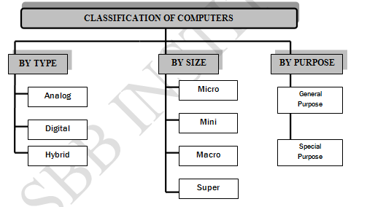

Slide 3
1. Analog Computers
Analog computer measures and answer the questions by the method of “HOW MUCH”. The input data is not a number infect a physical quantity like tem, pressure, speed, velocity.
Signals are continuous of (0 to 10 V)
Accuracy 1% Approximately
High speed
Output is continuous
Time is wasted in transmission time

Slide 4
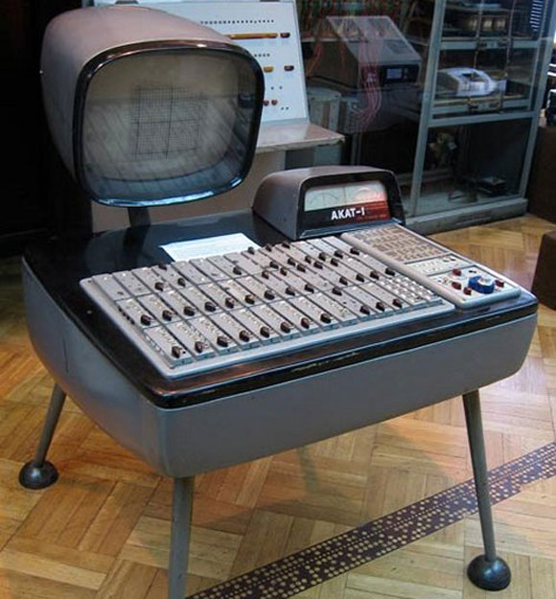
1. Analog Computers
Analog computers are used to process continuous data. Analog computers represent variables by physical quantities. Thus any computer which solve problem by translating physical conditions such as flow, temperature, pressure, angular position or voltage into related mechanical or electrical related circuits as an analog for the physical phenomenon being investigated in general it is a computer which uses an analog quantity and produces analog values as output. Thus an analog computer measures continuously. Analog computers are very much speedy. They produce their results very fast. But their results are approximately correct. All the analog computers are special purpose computers.

Slide 5
2.Digital Computer
Digital computer counts and answer the questions by the method of “HOW Many”. The input data is represented by a number. These are used for the logical and arithmetic operations.
Signals are two level of (0 V or 1 V)
Accuracy unlimited

Slide 6
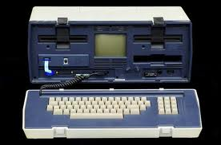
2.Digital Computer
Digital computer represents physical quantities with the help of digits or numbers. These numbers are used to perform Arithmetic calculations and also make logical decision to reach a conclusion, depending on, the data they receive from the user.

Slide 7
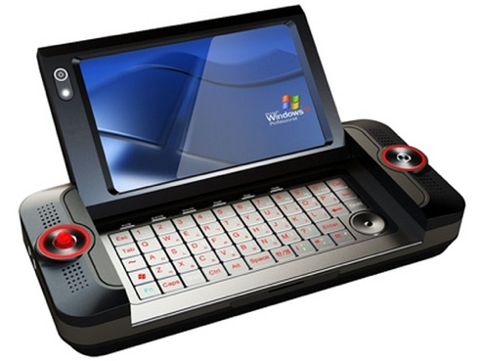
3. Hybrid Computers
Various specifically designed computers are with both digital and analog characteristics combining the advantages of analog and digital computers when working as a system. Hybrid computers are being used extensively in process control system where it is necessary to have a close representation with the physical world.
The hybrid system provides the good precision that can be attained with analog computers and the greater control that is possible with digital computers, plus the ability to accept the input data in either form.
Heart beat of patient, petrol pump

Slide 8
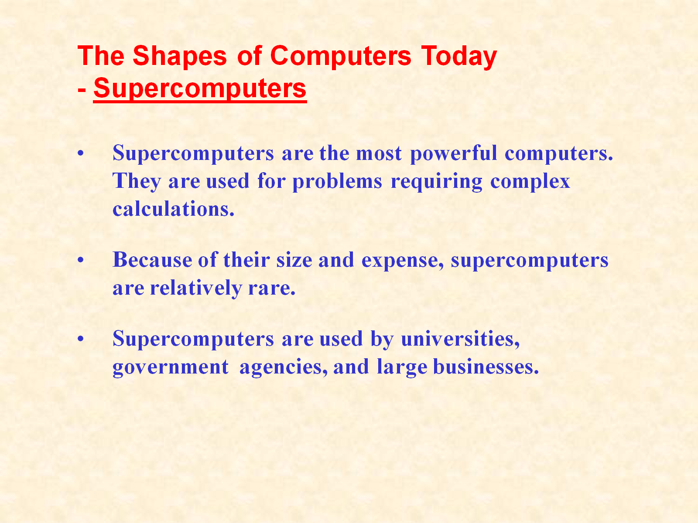

Slide 9
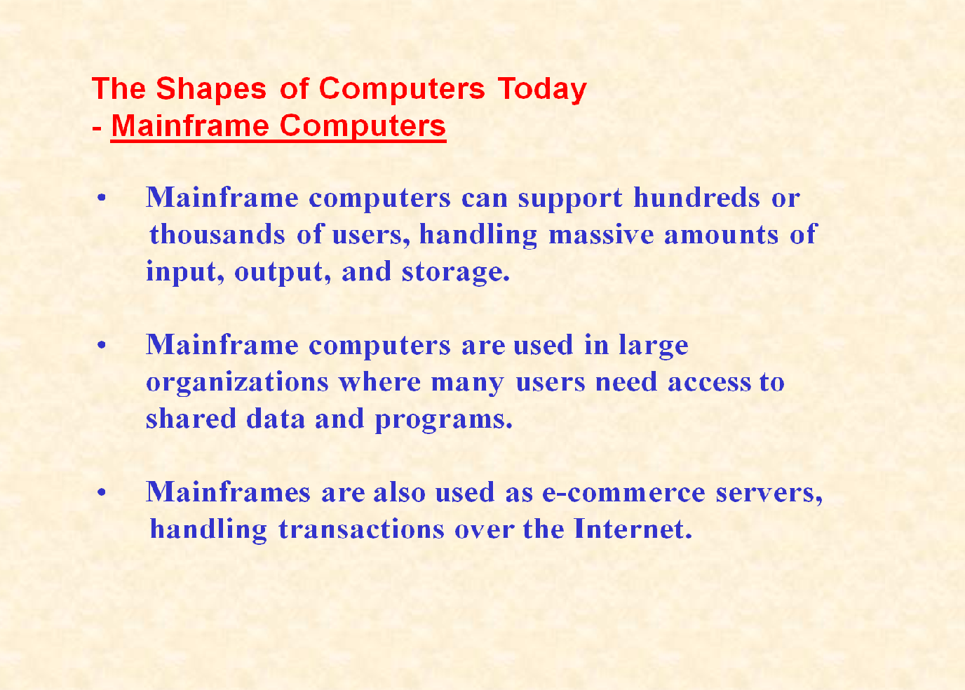

Slide 10
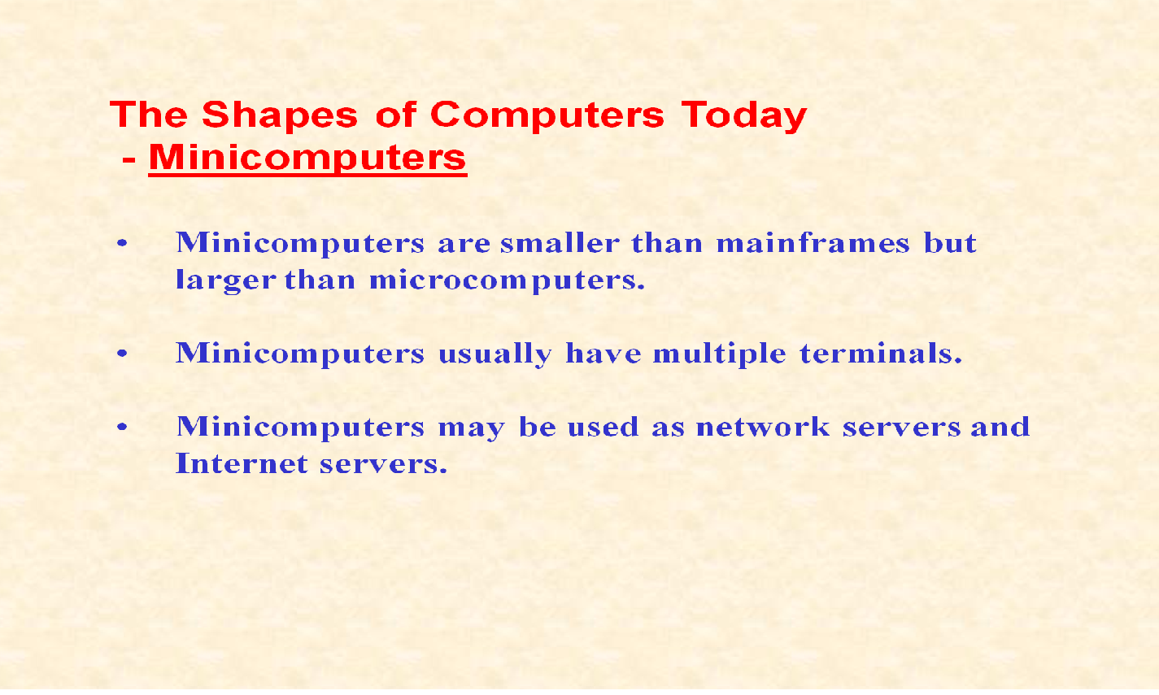

Slide 11
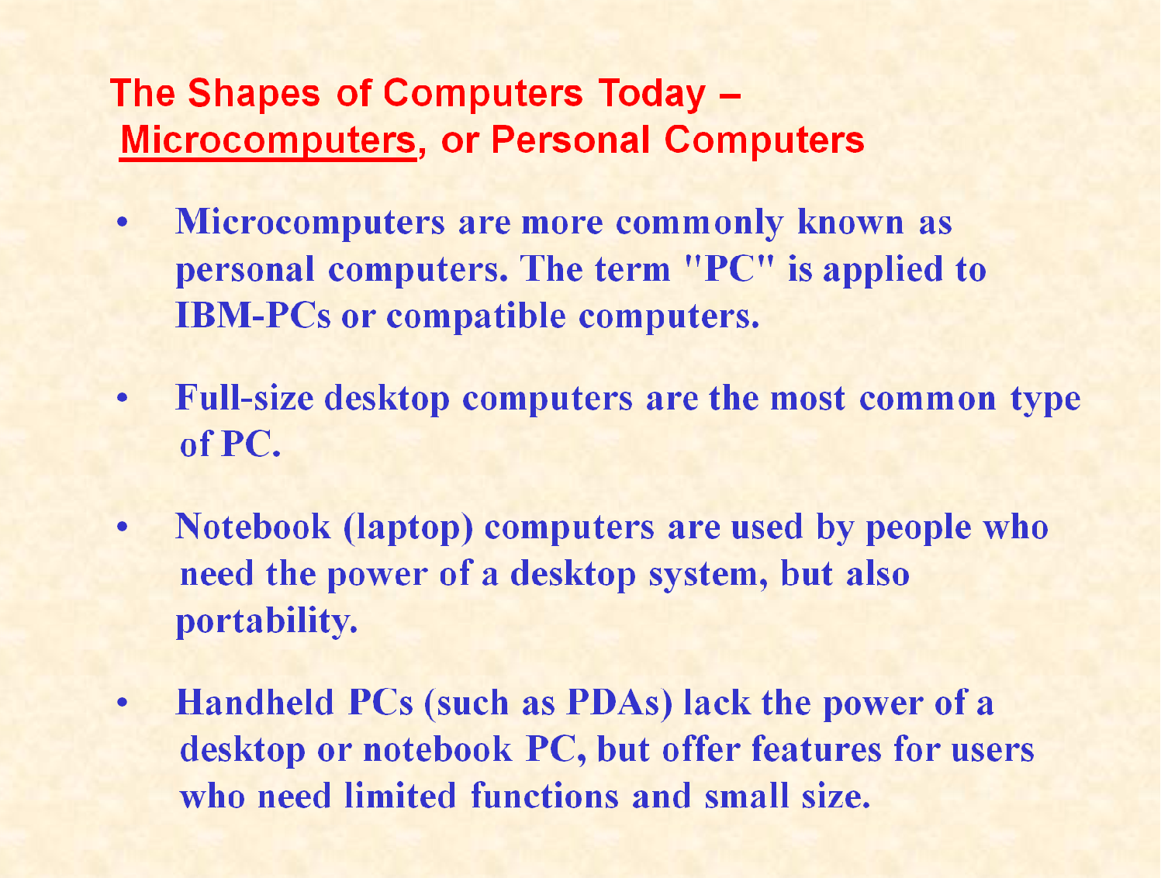

Slide 12


